Slide 1
Avoiding resource bottlenecks - Concurrency, threading and multiprocessing
Gavin Suddrey

Slide 2
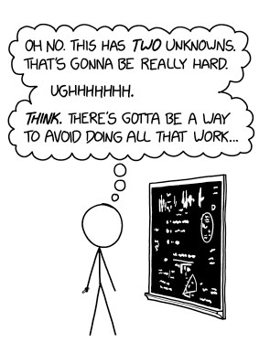
Bottlenecks
CPU Bound Processes
Lots of numbers be crunchen`
IO Bound Processes
Lots of waiting for files to read/download

Slide 3
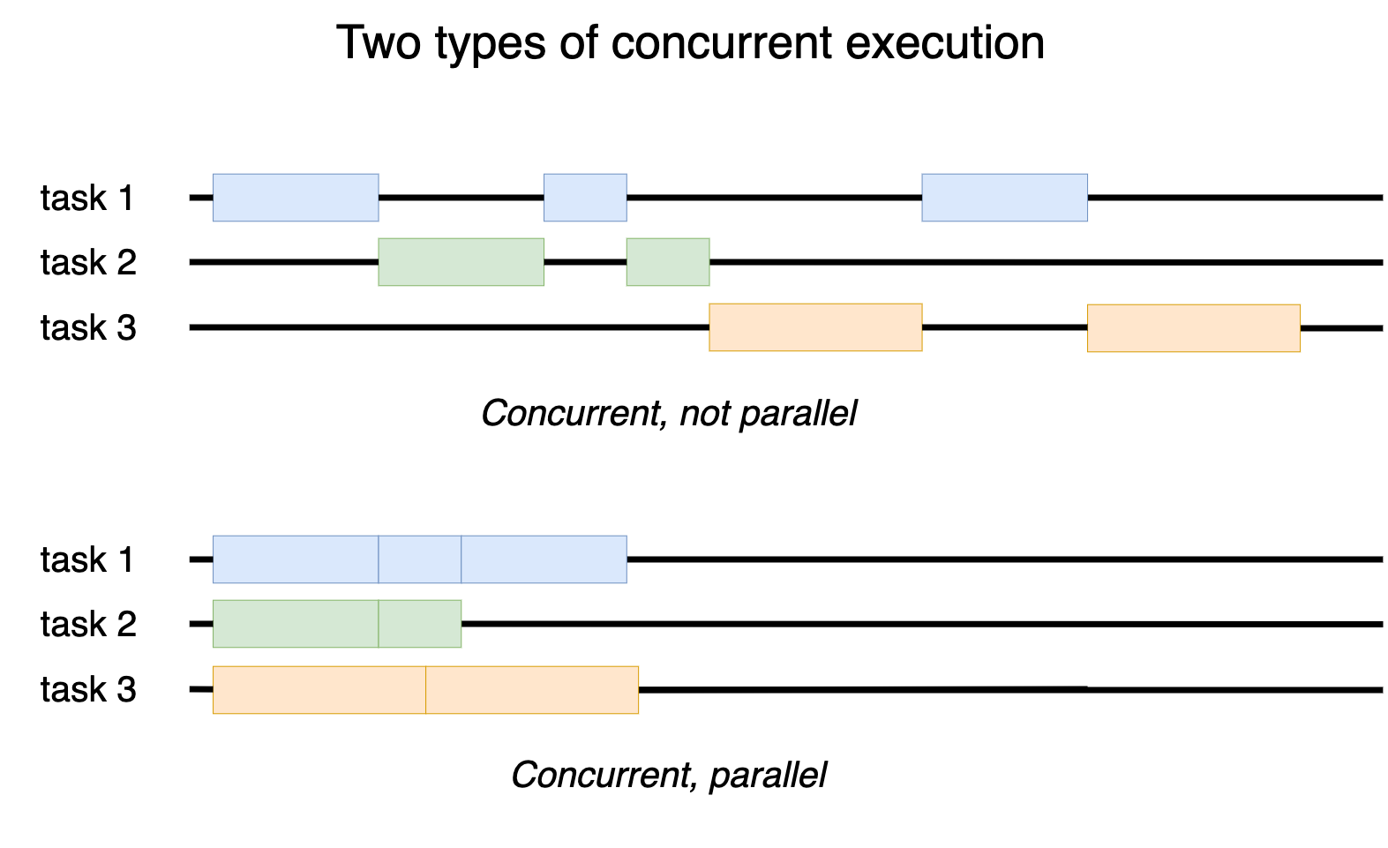

Slide 4
Thank you.
An end slide, or a quote slide.

